Slide 1

Performance-based Team Selection Team 6

Slide 2

Project analysis slide 3
Project Overview
Problem Statement
Dataset Description & Data Preparation
Descriptive analysis
Modeling
Results and Recommendations
Overview of NBA
Problem Definition
Approach and Assumptions
Datasets Used
Data Merging
Data Cleaning
Statistical summary major parameters
By Position –performance metrics
Correlation Matrices
Composition of a team
Best Subset Selection
Regression Model
Clustering Model
Recommend Players by position
Budget Selection Framework
Randomized Roster Generation

Slide 3
Thank You
Project Overview
Problem Statement
Dataset Description & Data Preparation
Descriptive analysis
Modeling
Results and Recommendations
Overview of NBA
Problem Definition
Approach and Assumptions
Datasets Used
Data Merging
Data Cleaning
Statistical summary major parameters
By Position –performance metrics
Correlation Matrices
Composition of a team
Best Subset Selection
Regression Model
Clustering Model
Recommend Players by position
Budget Selection Framework
Randomized Roster Generation

Slide 4
Project analysis slide 10
Overview of NBA
The National Basketball Association is a men's professional basketball league in North America
It is composed of 30 teams.
It is one of the four major professional sports leagues in the United States and Canada
Widely considered to be the premier men's professional basketball league in the world
There are typically 13-15 players in a team, who play in any of the 5 positions rotationally

Slide 5
Project analysis slide 10
Problem Statement
Indiana Pacers is an NBA team based out of Indianapolis, Indiana
Playing in the league since 1967, is currently owned by Herbert Simon, real estate developer, billionaire
The upper management wishes to dissolve the team and draft a new team
They will retain the top 5 performing players and from a set annual spend budget, draft a list of remaining 8 players
Recommend an analytics-based solution to support their decision on team selection

Slide 6
Project analysis slide 10
Our Approach
Our solution aims to balance the performance of a player with his salary – to get the best “bang-for-buck”
We identify top players to be retained for the upcoming season based on their performance
We derive the performance metric that determines a player’s influence on the match and thereby his value to the team
We use ‘PER’ (Performance Efficiency Rating) as a proxy parameter to derive this metric
We build a framework to dynamically generate a sample roster within given budget
Budget is allocated among the five positions and after accounting for the players retained, we propose a sample roster of high performing players who lie within the budget

Slide 7
Project analysis slide 10
Assumptions
Management wishes to retain the existing player count and position-wise player mix
They also wish to retain top 5 best performing players of the team from last season
The budget for the team’s cumulative salary is $114 Mn – this value is flexible; the solution can readjust recommendations based on this input
Salary for the previous season will be carried to the current season
Position of the players are immutable

Slide 8
Thank You
Project Overview
Problem Statement
Dataset Description & Data Preparation
Descriptive analysis
Modeling
Results and Recommendations
Overview of NBA
Problem Definition
Approach and Assumptions
Datasets Used
Data Merging
Data Cleaning
Statistical summary major parameters
By Position –performance metrics
Correlation Matrices
Composition of a team
Best Subset Selection
Regression Model
Clustering Model
Recommend Players by position
Budget Selection Framework
Randomized Roster Generation

Slide 9
Project analysis slide 4
Dataset 1: Season Stats
Description
The data-set contains aggregate individual statistics for 67 NBA seasons. from basic box-score attributes such as points, assists, rebounds etc., to more advanced money-ball like features such as Value Over Replacement
Overview of the key parameters*
Parameter | Description | Parameter | Description
2P | 2-Point Field Goals | GS | Games Started
2P% | 2-Point Field Goal Percentage | MP | Minutes Played
3P | 3-Point Field Goals | ORB | Offensive Rebounds
3P% | 3-Point Field Goal Percentage | ORB% | Offensive Rebound Percentage
Age | Age | OWS | Offensive Win Shares
AST | Assists | PER | Player Efficiency Rating
AST% | Assist Percentage | PF | Personal Fouls
BLK | Blocks | PTS | Points
BLK% | Block Percentage | STL | Steals
BPM | Box Plus/Minus | STL% | Steal Percentage
DRB | Defensive Rebounds | Tm | Team
DRB% | Defensive Rebound Percentage | TOV | Turnovers
DWS | Defensive Win Shares | TOV% | Turnover Percentage
eFG% | Effective Field Goal Percentage | TRB | Total Rebounds
FG | Field Goals | TRB% | Total Rebound Percentage
FG% | Field Goal Percentage | TS% | True Shooting Percentage
FGA | Field Goal Attempts | Usg% | Usage Percentage
FT | Free Throws | VORP | Value Over Replacement Player
FT% | Free Throw Percentage | WS | Win Shares
G | Games | Year | Year that the season occurred- the year given is the last year for that season
Data Parameters
The dataset includes info on 72 parameters including Age, Points Scored, Year, etc.
The data ranges from 1951-2017: However, we are concerned with the data points from 2013 onward only
Data Munging
Filter the dataset to include data from 2013 to 2017 only
Aggregate the parameters using “player” and ”year” as the key – to account for player transfers between teams
Separate the “Indiana Pacers” team from the training set to avoid overfitting
*(Non-exhaustive list)

Slide 10
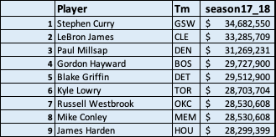
Project analysis slide 4
Dataset 2: Salary
Description
The data-set simply contains information about all NBA players’ salary in 2017-2018 Season.
Overview of the Parameters
Parameter | Description
Player | NBA players’ name
Tm | Team name each player belongs to at the beginning of the 2017-2018 season
Season17_18 | Salary price for 2017-2018 season (USD)
Data Parameters
The data-set shows players’ salary amount 450+ NBA players in 2017-2018 season.
Along with the salary amount, it also includes players’ name and their team
First Multi-lines of the Data-set
Data Munging
This database is clearly enough for data-merging later

Slide 11
Project analysis slide 4
Dataset Manipulation
2013-16 data is used as the ‘training set’ to build the model to evaluate player performance score
Dataset 1: 2013-16
Dataset 1:
Season_Stats
Used as the test dataset to calculate the “PER” score
Dataset 1:
2017
Consolidated Dataset
Descriptive Statistics
Descriptive Statistics
Modeling
Interpretation and results
Left Merge on
‘Player name’
Salary dataset merged with the player stats to manage team budget
Dataset 2: Salary

Slide 12
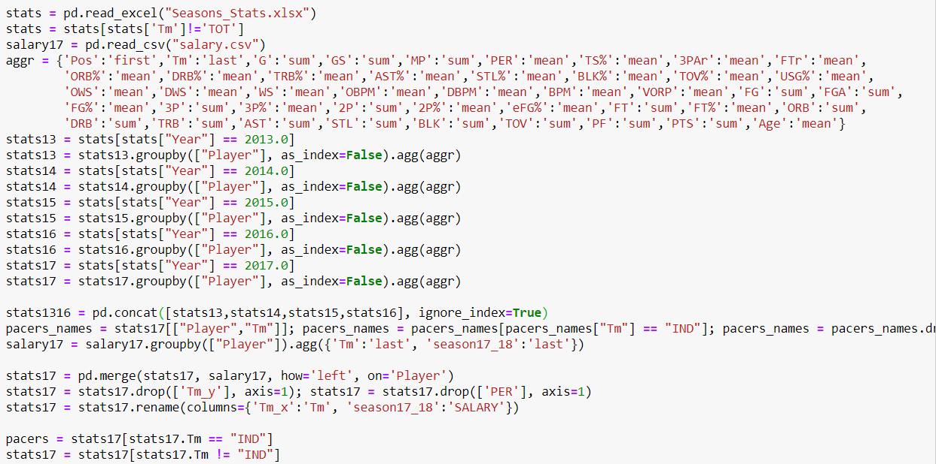
Dataset: Data Munging (algorithm)
We used “Pandas” for data manipulation and preparation
Notes:
1.

Slide 13
Project Overview
Problem Statement
Dataset Description & Data Preparation
Descriptive analysis
Modeling
Results and Recommendations
Overview of NBA
Problem Definition
Approach and Assumptions
Datasets Used
Data Merging
Data Cleaning
Statistical summary major parameters
By Position –performance metrics
Correlation Matrices
Composition of a team
Best Subset Selection
Regression Model
Clustering Model
Recommend Players by position
Budget Selection Framework
Randomized Roster Generation

Slide 14
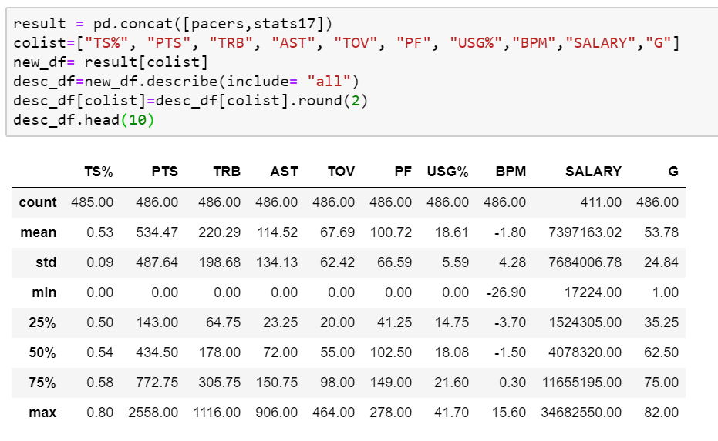
Project analysis slide 6
Statistical summary
of performance metrics

Slide 15
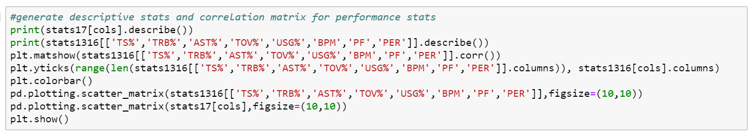
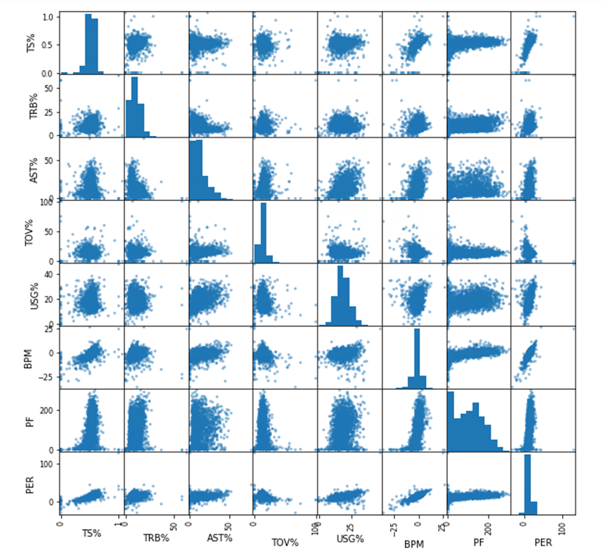
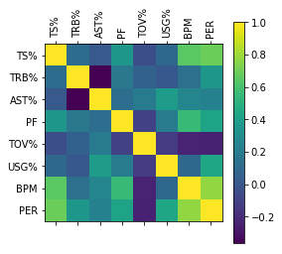
Project analysis slide 6
Correlation heatmap

Slide 16
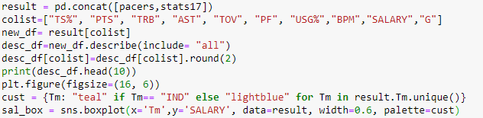
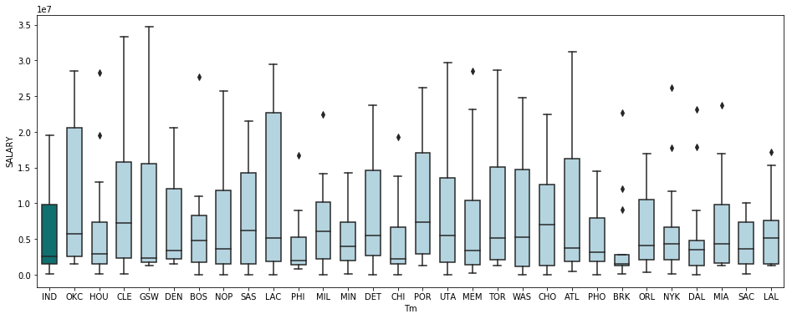
Project analysis slide 6
Salary distribution
of players in a team
Salary distribution of players is highly uneven across teams
Based on several factors different teams have different caps on budgets and pay varied salaries

Slide 17
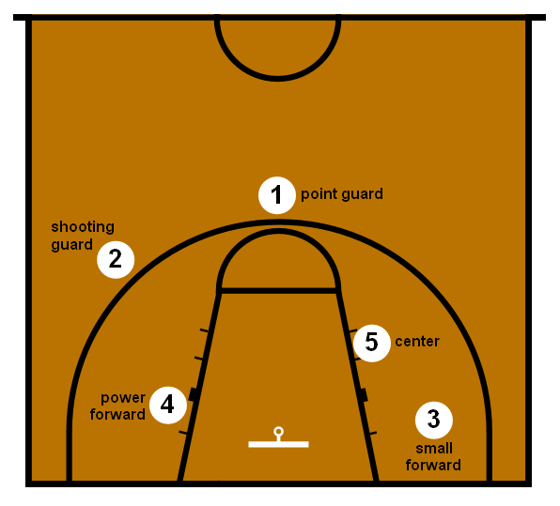
Project analysis slide 6
Basketball positions
The shooting guard (SG) are mostly prolific from the three-point range. Besides being able to shoot the ball, shooting guards tend to be the best defender on the team, as well as being able to move without the ball to create open looks for themselves
Average salary - $5.31mn
The point guard (PG), also known as the one, is typically the team's best ball handler and passer. Therefore, they often lead their team in assists and can create shots for themselves and their teammates.
Average salary - $6.33mn
The center (C), usually plays near the baseline or close to the basket. They are usually the tallest players on the floor. They are typically skilled at gathering rebounds, contesting shots and setting screens on plays.
Average salary - $7.22mn
The power forward (PF), also known as the four, often plays a role like that of the center, being able to score close to the basket while also being able to shoot mid-range jump shots from 12 to 18 feet from the basket.
Average salary - $5.64mn
The small forward (SF) is the most versatile of the main five basketball positions. Perform duties of both SG and PF
Average salary - $7.13mn

Slide 18
Overview of Positions

Slide 19
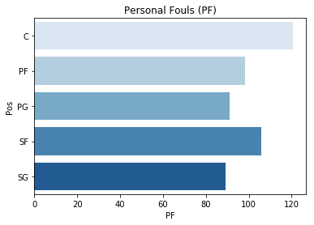
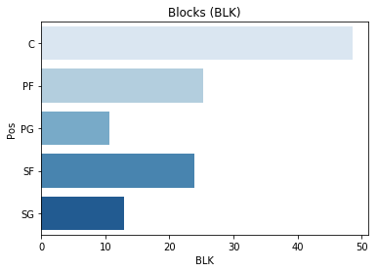
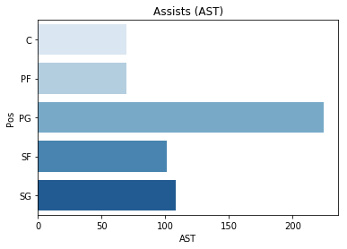
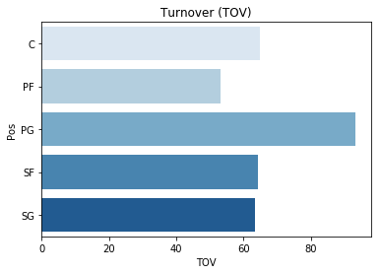
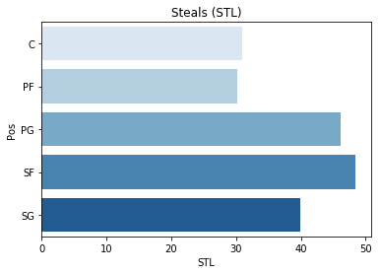
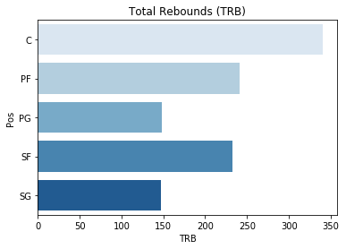
Project analysis slide 6
Position comparison
performance metrics

Slide 20
Project Overview
Problem Statement
Dataset Description & Data Preparation
Descriptive analysis
Modeling
Results and Recommendations
Overview of NBA
Problem Definition
Approach and Assumptions
Datasets Used
Data Merging
Data Cleaning
Statistical summary major parameters
By Position –performance metrics
Correlation Matrices
Composition of a team
Best Subset Selection
Regression Model
Clustering Model
Recommend Players by position
Budget Selection Framework
Randomized Roster Generation

Slide 21
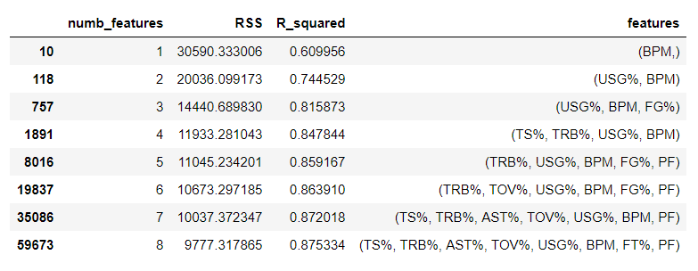
Parameter Selection
(Best subset selection)
Output from the best subset algorithm¹ highlighting top features
Total: 72 parameters
17 parameters
7 parameters
Identified collinear and redundant parameters such as ‘2P’, ‘OWS’, ‘DWS’
Shortlist 17 parameters that could impact the performance value
Applied best sub-set selection¹ on the shortlisted parameters
Ridge regression provided the highest R2 value
We restrict ourselves to 7 parameters as the incremental explanation from adding the 7th variable is negligible
Using this 3-step approach, we arrived at the 7 most optimal parameters for regression viz.,
'TS%’, 'TRB%’, 'AST%’, 'TOV%’, 'USG%’, 'BPM’, ‘PF’

Slide 22
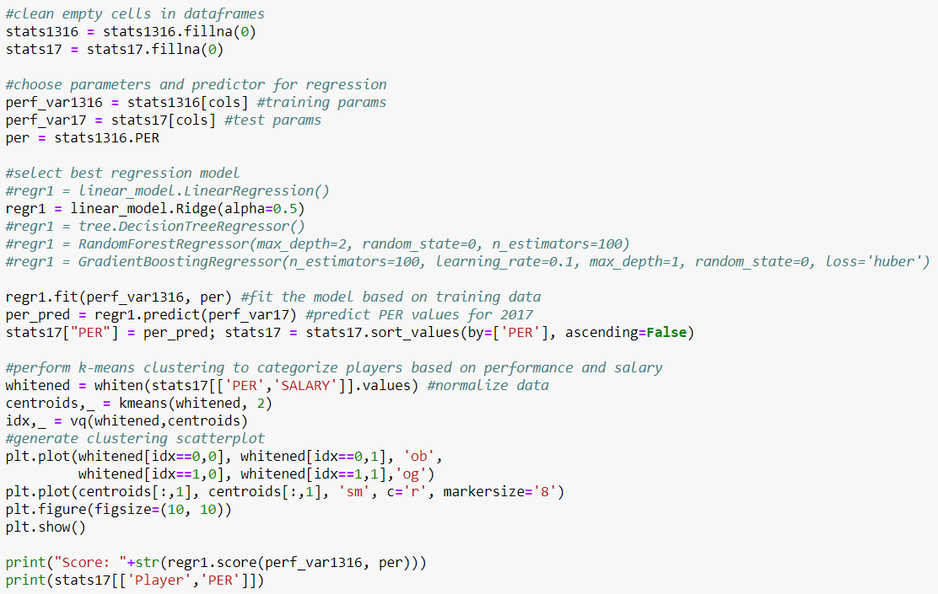
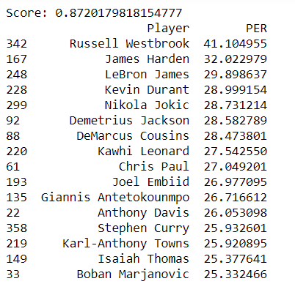
Regression Model
Regression Code
Sample Output
We tried the following regression models (from Sklearn library):
Linear Regression
Ridge
Decision Tree Regressor
Random-Forest Regressor
Gradient Boosting Regressor
Ridge model gave the best R² value

Slide 23
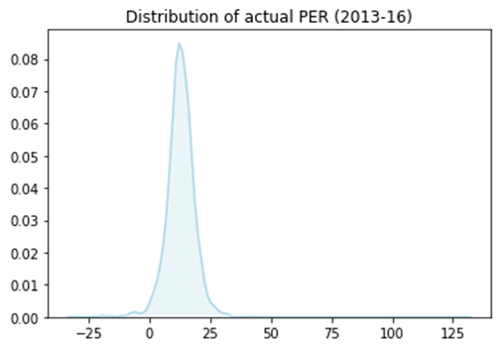
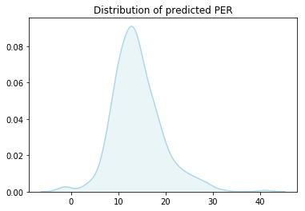
Project analysis slide 6
Distribution of
predicted PER
As discussed previously, PER summarizes a player's statistical accomplishments in a season
The distribution of the ‘PER’ as predicted by our model, mimics the distribution of the ‘actual PER’ metric for the previous seasons (2013-16)
For the predicted PER, Mean is 13.28 with SD of 5.91

Slide 24
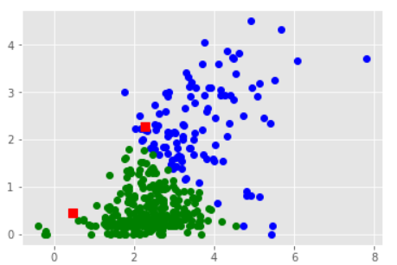
Clustering Model
Clustering Code
Sample Output
We implemented the k-means clustering to identify patterns based on performance and salary (from SciPy library):
The variation of “blue” (i.e. high performance, high salary) players is relatively higher
We identified that the high variation in salaries of top performers becomes increasingly difficult to predict their salaries
This implies that it is challenging to predict salaries purely based on performance – other factors such as team performance, negotiation power of the player and team management play a critical role in determining the salaries

Slide 25
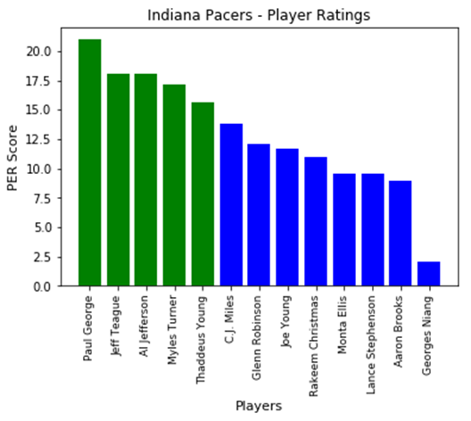
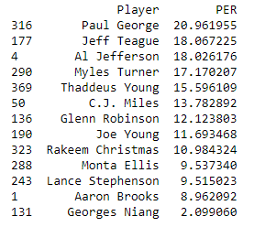
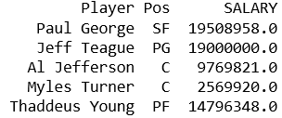
Players to be retained
Top 5 players to be retained in the team based on the model
Top 5 players to be retained in the team based on the model
Total Salary: $65,645,047
Based on the ‘PER’ score derived from the regression model, we identified the top 5 players to be retained and their subsequent positions and salaries
This gives us the available budget for salary and the vacant positions that need to be filled

Slide 26
Project Overview
Problem Statement
Dataset Description & Data Preparation
Descriptive analysis
Modeling
Results and Recommendations
Overview of NBA
Problem Definition
Approach and Assumptions
Datasets Used
Data Merging
Data Cleaning
Statistical summary major parameters
By Position –performance metrics
Correlation Matrices
Composition of a team
Best Subset Selection
Regression Model
Clustering Model
Recommend Players by position
Budget Selection Framework
Randomized Roster Generation

Slide 27
Budget allocation framework
I
P1
II
Formula for estimating budget for each position
P1
P1
Σ(Salary of top retained player)
P2
# Avg. Salary for the position
# Players planned for that position
Normal-ization factor¹
Total Budget
P3
P4
Team’s budget is split into different positions
based on ratio of team sizes, avg. salary for that position, ratio of count of players for that position (Pacers vs NBA avg.)
Account for salaries of star players
Salaries of the retained players are subtracted from respective positions to get available budget
P5
III
P1
Σ(Salary of new recruits in that position)
Identify top performing players who lie within the budget for each position
Generate a roster of top ranked players by performance that can meet the budget requirements
P1
Position 1
1. Normalization factor is defined as the following ratio: (Avg. count of players in team)/(#Players in Indiana Pacers)*(Total team budget)/(Avg. NBA team budget)

Slide 28
Budget Reallocation
Position | # Players | Normalized budget split | #Retained | Salaries of Retained | Vacancy # | Budget Available | Reallocated budget
SG | 2 | $ 15,676,491 | 0 | $ - | 2 | $ 15,676,491 | $ 15,676,491
SF | 3 | $ 28,270,427 | 1 | $ 19,508,958.00 | 2 | $ 8,761,469 | $ 8,761,469
PG | 3 | $ 25,720,455 | 1 | $ 19,000,000.00 | 2 | $ 6,720,455 | $ 13,346,650
C | 2 | $ 18,965,936 | 2 | $ 12,339,741.00 | 0 | $ 6,626,195 | $ -
PF | 3 | $ 25,601,576 | 1 | $ 14,796,348.00 | 2 | $ 10,805,228 | $ 10,805,228
 | 13 | $ 114,000,000 | 5 | $ 65,645,047.00 | 8 | $ 48,589,838
Based on the framework, we arrived at the following budget constraints for the different positions
Since the list of retained star players include 2 in ‘center’ position, we do not need to recruit any more ‘Centers’
We decided to reallocate the budget to point guard as a strategy to include more all-round players that can create a stronger impact on the game

Slide 29
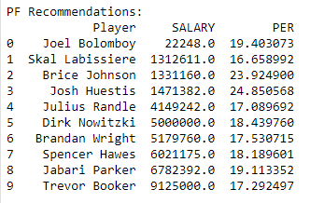
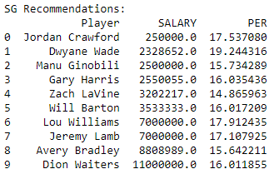
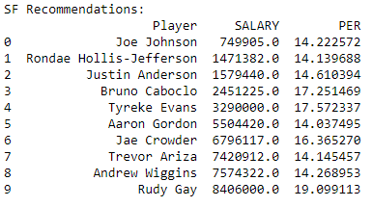
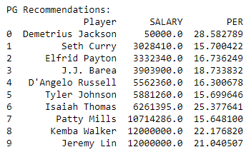
List of suggested
top players by position
Players are grouped into their respective playing positions
The recommendation list for each position is based on PER among the players in the same group.
From these top 10 players, we then use a selection logic to randomly select 8 players
The algorithm will select only the players who fit the following criteria:
Cumulative salary fits the specified budget
Count of players for each position align with the vacancies available

Slide 30
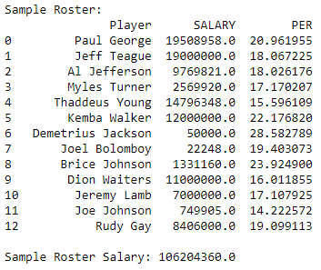
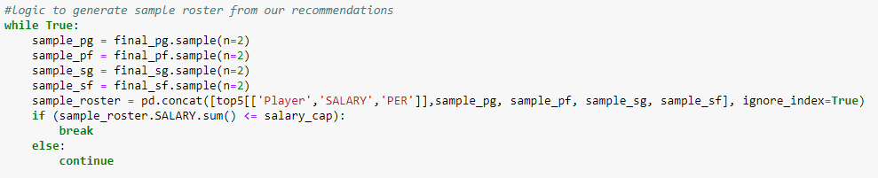
Recommended Player Roster
The sample roster is what the final team could look like
The total salary expenditure is $106Mn for this roster.
We use random sampling from our recommendation pool. The composition of the players would change every time the program executes
The recommended roster would also update based on the allocated budget
The management can use this as the basis for identifying players to form their team for the next season

Slide 31
Tools and Libraries covered
S.N | Libraries used | Functions used | Application in our project
1 | itertools | .combinations | generate combos for best subset selection
2 | pandas | .read, .concat, .merge, .DataFrame, .plotting.scatter_matrix, .drop, .fillna, .sample | data manipulation and cleaning
3 | numpy | .arange, | generate descriptive stats
4 | matplotlib | .plot, .bar, .matshow, .colorbar, .show, .title | data visualization
5 | seaborn | .boxplot, .kdeplot, .barplot | data visualization
6 | sklearn | linear_model.Ridge, .predict, .score, .fit, mean_squared_error | regression
7 | scipy | Vq, kmeans, whitened | clustering

Slide 32
Thank You

Slide 33
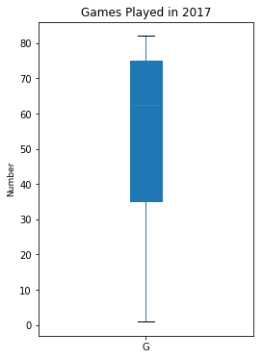
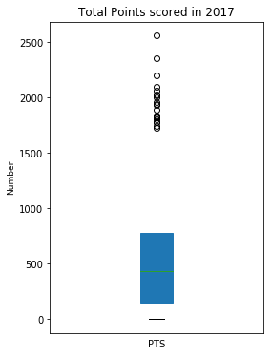
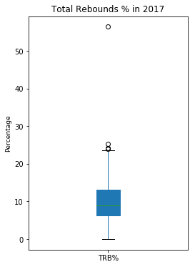
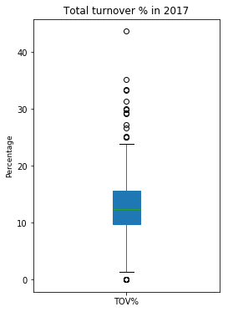
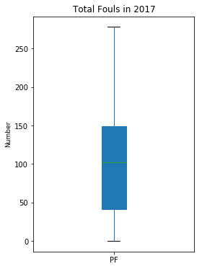
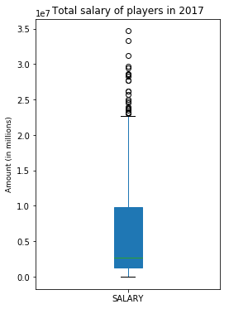
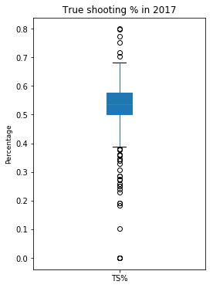
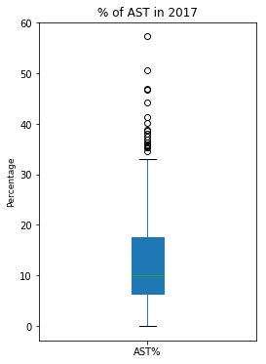
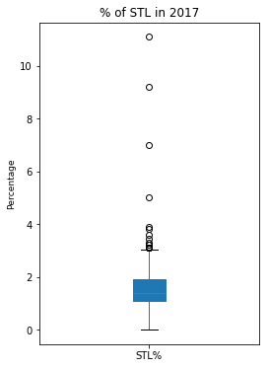
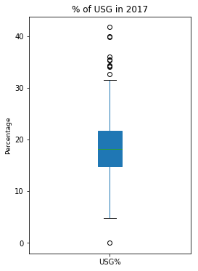
Project analysis slide 6
Appendix A: Box-plot

Slide 34
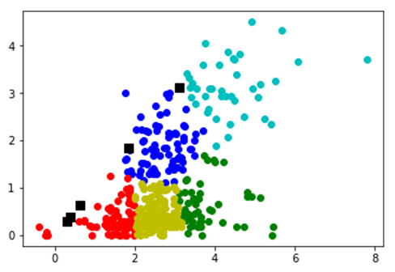
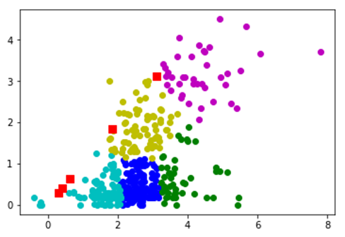
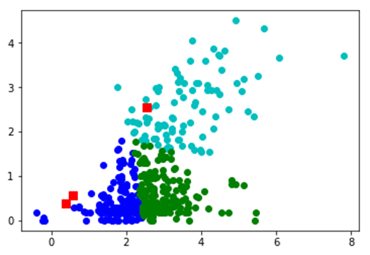
Project analysis slide 6
Appendix B:
Clustering Model Simulations

Slide 35
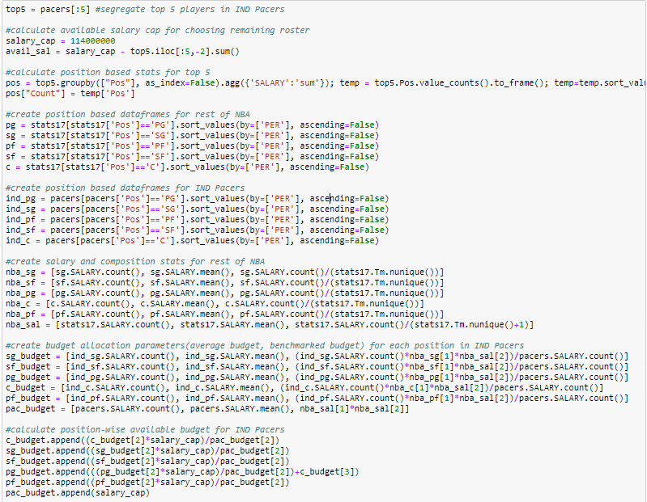
Project analysis slide 6
Appendix C: Budget Allocation

Slide 36
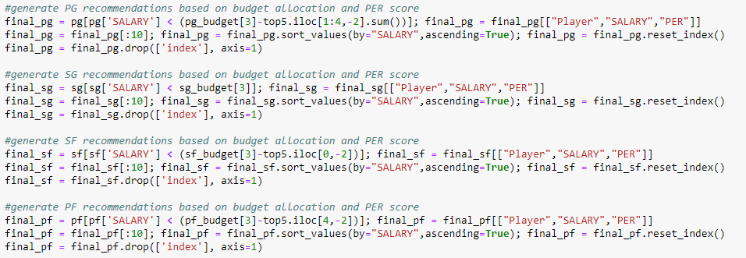
Project analysis slide 6
Appendix D: Player Recommendations

